Slide 1

Entity Relations
Customizing Entity Models
SoftUni Team
Technical Trainers
Software University
http://softuni.bg

Slide 2
Table of Contents
Object Composition
Navigation Properties
Fluent API
Table Relationships

Slide 3
Have a Question?
sli.do
#csharp-db

Slide 4

Object Composition
Describing Database Relationships

Slide 5
Object Composition
Object composition denotes a "has-a" relationship
E.g. the car has an engine
Defined in C# by one object having a property that is a reference to another
Person
Dog
Name
Name
Age
Age
Pet

Slide 6
Navigation Properties
Navigation properties create a relationship between entities
Is either an Entity Reference (one to one or zero) or an ICollection (one to many or many to many)
They provide fast querying of related records
Can be modified by directly setting the reference

Slide 7
f() => API
Fluent API
Working with Model Builder

Slide 8
Fluent API
Code First maps your POCO classes to tables using a set of conventions
E.g. property named "Id" maps to the Primary Key
Can be customized using annotations and the Fluent API
Fluent API (Model Builder) allows full control over DB mappings
Custom names of objects (columns, tables, etc.) in the DB
Validation and data types
Define complicated entity relationships

Slide 9
Working with Fluent API
Custom mappings are placed inside the OnModelCreating method of the DB context class
protected override void OnModelCreating(DbModelBuilder builder)
{
builder.Entity<Student>().HasKey(s => s.StudentKey);
}

Slide 10
Fluent API: Renaming DB Objects
Specifying Custom Table name
Custom Column name/DB Type
modelBuilder.Entity<Order>()
.ToTable("OrderRef", "Admin");
Optional schema name
modelBuilder.Entity<Student>()
.Property(s => s.Name)
.HasColumnName("StudentName")
.HasColumnType("varchar");

Slide 11
Fluent API: Column Attributes
Explicitly set Primary Key
Other column attributes
modelBuilder
.Entity<Student>().HasKey("StudentKey");
modelBuilder.Entity<Person>()
.Property(p => p.FirstName)
.IsRequired()
.HasMaxLength(50)
modelBuilder.Entity<Post>()
.Property(p => p.LastUpdated)
.ValueGeneratedOnAddOrUpdate()

Slide 12
Fluent API: Miscellaneous Config
Do not include property in DB (e.g. business logic properties)
Disabling cascade delete
If a FK property is non-nullable, cascade delete is on by default
modelBuilder
.Entity<Department>().Ignore(d => d.Budget);
modelBuilder.Entity<Course>()
.HasRequired(t => t.Department)
.WithMany(t => t.Courses)
.HasForeignKey(d => d.DepartmentID)
.OnDelete(DeleteBehavior.Restrict);
Throws exception on delete

Slide 13
Specialized Configuration Classes
Mappings can be placed in entity-specific classes
Include in OnModelCreating:
public class StudentConfiguration
: IEntityTypeConfiguration<Student>
{
public void Configure(EntityTypeBuilder<Student> builder)
{
builder.HasKey(c => c.StudentKey);
}
}
Specify target model
builder.ApplyConfiguration(new StudentConfiguration());

Slide 14

Table Relationships
Expressed as Properties and Attributes

Slide 15
One-to-Zero-or-One
Expressed in SQL Server as a shared primary key
Relationship direction must be explicitly specified with a ForeignKey attribute
ForeignKey is placed above the key property and contains the name of the navigation property and vice versa
Student
Address

Slide 16
One-to-Zero-or-One: Implementation
Using the ForeignKey Attribute
public class Student
{
[Key]
public int Id { get; set; }
public string Name { get; set; }
public int AddressId { get; set; }
[ForeignKey("Address")]
public Address Address { get; set; }
}
Attributes

Slide 17
One-to-Zero-or-One: Implementation (2)
Using the ForeignKey Attribute
public class Address
{
public int Id { get; set; }
public string Text { get; set; }
public int StudentId { get; set; }
[ForeignKey(nameof(Student))]
public Student Student { get; set; }
}

Slide 18
One-to-Zero-or-One: Fluent API
HasOne ➔ WithOne
If StudentId property is nullable (int?), relation becomes One-To-Zero-Or-One
modelBuilder.Entity<Address>()
.HasOne(a => a.Student)
.WithOne(s => s.Address)
.HasForeignKey(a => a.StudentId);
Address contains FK to Student

Slide 19
One-to-Many
Most common type of relationship
Implemented with a collection inside the parent entity
The collection should be initialized in the constructor!
Employee
Department
Employee
Employee

Slide 20
One-to-Many: Implementation
Department has many employees
public class Department
{
public int Id { get; set; }
public string Name { get; set; }
public ICollection<Employee> Employees { get; set; }
}

Slide 21
One-to-Many: Implementation (2)
Employees have one department
public class Employee
{
public int Id { get; set; }
public string FirstName { get; set; }
public string LastName { get; set; }
public int DepartmentId { get; set; }
public Department Department { get; set; }
}

Slide 22
One-to-Many: Fluent API
HasMany ➔ WithOne
modelBuilder.Entity<Post>()
.HasMany(p => p.Comments)
.WithOne(c => c.Post)
.HasForeignKey(c => c.PostId);
modelBuilder.Entity<Employee>()
.HasMany(e => e.Addresses)
.WithOne(a => a.Employee)
.HasForeignKey(a => a.EmployeeId);

Slide 23
Many-to-Many
Requires a join entity (separate class) in EF Core
Implemented with collections in each entity, referring the other
Student
Course
Student
Course
Student

Slide 24
Many-to-Many Implementation (1)
public class Course
{
public string Name { get; set; }
public ICollection<StudentCourse> StudentsCourses { get; set; }
}
public class Student
{
public string FirstName { get; set; }
public string LastName { get; set; }
public ICollection<StudentCourse> StudentsCourses { get; set; }
}

Slide 25
Many-to-Many Implementation (2)
EF Core requires a Join Entity
public class StudentCourse
{
public int StudentId { get; set; }
public Student Student { get; set; }
public int CourseId { get; set; }
public Course Course { get; set; }
}

Slide 26
Many-to-Many: Fluent API
Mapping both sides of relationship
modelBuilder.Entity<StudentCourse>()
.HasKey(sc => new { sc.StudentId, sc.CourseId });
builder.Entity<StudentCourse>()
.HasOne(sc => sc.Student)
.WithMany(s => s.StudentCourses)
.HasForeignKey(sc => sc.StudentId);
builder.Entity<StudentCourse>()
.HasOne(sc => sc.Course)
.WithMany(s => s.StudentCourses)
.HasForeignKey(sc => sc.CourseId);
Composite Primary Key

Slide 27
Multiple Relations
When two entities are related by more than one key
Entity Framework needs help from Inverse Properties
Place of Birth
Town
Person
Current Residence
Town

Slide 28
Multiple Relations Implementation
Person Domain Model – defined as usual
public class Person
{
public int Id { get; set; }
public string Name { get; set; }
public Town PlaceOfBirth { get; set; }
public Town CurrentResidence { get; set; }
}

Slide 29
Multiple Relations Implementation (2)
Town Domain Model
public class Town
{
public int Id { get; set; }
public string Name { get; set; }
[InverseProperty("PlaceOfBirth")]
public ICollection<Person> Natives { get; set; }
[InverseProperty("CurrentResidence")]
public ICollection<Person> Residents { get; set; }
}
Point towards related property

Slide 30
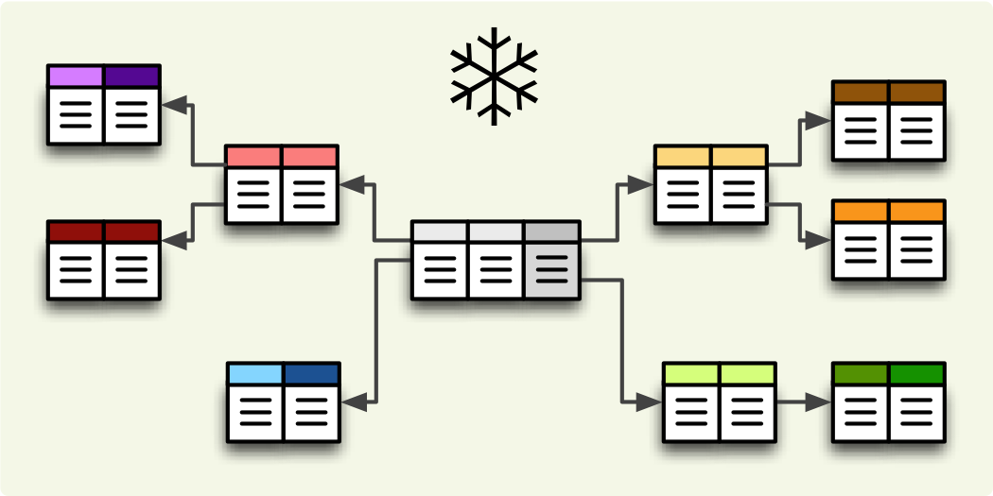
Filtering and Aggregating Tables
Select, Join and Group Data Using LINQ

Slide 31
Good Reasons to Use Select
Limit network traffic by reducing the queried columns
Syntax:
SQL Server Profiler
var employeesWithTown = context
.Employees
.Select(employee => new
{
EmployeeName = employee.FirstName,
TownName = employee.Address.Town.Name
});
SELECT [employee].[FirstName] AS [EmployeeName], [employee.Address.Town].[Name] AS [TownName]
FROM [Employees] AS [employee]
LEFT JOIN [Addresses] AS [employee.Address] ON [employee].[AddressID] = [employee.Address].[AddressID]
LEFT JOIN [Towns] AS [employee.Address.Town] ON [employee.Address].[TownID] = [employee.Address.Town].[TownID]

Slide 32
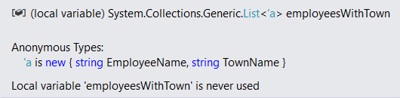
Good Reasons not to Use Select
Data that is selected is not of the initial entity type
Anonymous type, generated at runtime
Data cannot be modified (updated, deleted)
Entity is of a different type
Not associated with the context anymore

Slide 33
Joining Tables in EF: Using Join()
Join tables in EF with LINQ / extension methods on IEnumerable<T> (like when joining collections)
var employees =
softUniEntities.Employees.Join(
softUniEntities.Departments,
(e => e.DepartmentID),
(d => d.DepartmentID),
(e, d) => new {
Employee = e.FirstName,
JobTitle = e.JobTitle,
Department = d.Name
}
);

Slide 34
Grouping Tables in EF
Grouping also can be done by LINQ
The same way as with collections in LINQ
Grouping with LINQ:
Grouping with extension methods:
var groupedEmployees =
from employee in softUniEntities.Employees
group employee by employee.JobTitle;
var groupedCustomers = softUniEntities.Employees
.GroupBy(employee => employee.JobTitle);

Slide 35

Result Models
Simplifying Models

Slide 36
Result Models
Select(), GroupBy() can work with custom classes
Allows you to pass them to methods and use them as a return type
Requires some extra code (class definition)
Sample Result Model:
public class UserResultModel
{
public string FullName { get; set; }
public string Age { get; set; }
}

Slide 37
Result Models (2)
Assign the fields as you would with an anonymous object:
The new type can be used in a method signature:
var currentUser = context.Users
.Where(u => u.Id == 8)
.Select(u => new UserResultModel
{
FullName = u.FirstName + " " + u.LastName,
Age = u.Age
})
.SingleOrDefault();
public UserResultModel GetUserInfo(int Id) { … }

Slide 38

Attributes
Custom Entity Framework Behavior

Slide 39
Attributes
EF Code First provides a set of DataAnnotation attributes
You can override default Entity Framework behavior
To access nullability and size of fields:
To access schema customizations:
For a full set of configuration options you need the Fluent API
using System.ComponentModel.DataAnnotations;
using System.ComponentModel.DataAnnotations.Schema;

Slide 40
Key Attributes
[Key] – explicitly specify primary key
When your PK column doesn’t have an "Id" suffix
Composite key is only defined using Fluent API for now
[Key]
public int StudentKey { get; set; }
builder.Entity<EmployeesProjects>()
.HasKey(k => new { k.EmployeeId, k.ProjectId });

Slide 41
Key Attributes (2)
ForeignKey – explicitly link navigation property and foreign key property within the same class
Works in either direction (FK to navigation property or navigation property to FK)
public class Client
{
…
[ForeignKey("Order")]
public int OrderRefId { get; set; }
public Order Order { get; set; }
}

Slide 42
Renaming Objects
Table – manually specify the name of the table in the DB
[Table("StudentMaster")]
public class Student
{
…
}
[Table("StudentMaster", Schema = "Admin")]
public class Student
{
…
}

Slide 43
Renaming Objects (2)
Column – manually specify the name of the column in the DB
You can also specify order and explicit data type
public class Student
{
…
[Column("StudentName", Order = 2, TypeName="varchar(50)")]
public string Name { get; set; }
}
Optional parameters

Slide 44
Entity Validation
Required – mark a nullable property as NOT NULL in the DB
Will throw an exception if not set to a value
Non-nullable types (e.g. int) will not throw an exception (will be set to language-specific default value)
MinLength – specifies min length of a string (client validation)
MaxLength / StringLength – specifies max length of a string (both client and DB validation)
Range – set lower and/or upper limits of numeric property (client validation)

Slide 45
Other Attributes
Index – create index for column
Primary key will always have an index
NotMapped – property will not be mapped to a column
For business logic properties
builder.Entity<Car>()
.HasIndex(u => u.RegistrationNumber)
.IsUnique();

Slide 46
Validation Method
Add using:
Create following method to validate entities:
using System.ComponentModel.DataAnnotations;
private bool IsValid(object obj)
{
var validationContext = new ValidationContext(obj);
var validationResults = new List<ValidationResult>();
return Validator.TryValidateObject(obj, validationContext, validationResults, true);
}

Slide 47

Shadow Properties

Slide 48
Shadow Properties
Shadow properties are not defined in your .NET entity class
They are useful when there is data in the database that should not be exposed on the mapped entity types.
Configure shadow property:
Change value of shadow property:
builder.Entity<Project>() .Property<DateTime>("LastUpdated");
context.Entry(Project).Property("LastUpdated")
.CurrentValue = DateTime.Now;

Slide 49

Summary
…
…
…
Objects can be composed from other objects to represent complex relationships
Navigation properties speed up the traversal of related entities

Slide 50
Summary
…
…
…
The Fluent API gives us full control over Entity Framework object mappings
Information overhead can be limited by selecting only the needed properties
ResultModels can be used to move aggregated data between methods
Attributes can be used to express special table relationships and to customize entity behaviour

Slide 51
https://softuni.bg/courses/databases-advanced-entity-framework

Slide 52




Trainings @ Software University (SoftUni)
Software University – High-Quality Education and Employment Opportunities
softuni.bg
Software University Foundation
http://softuni.foundation/
Software University @ Facebook
facebook.com/SoftwareUniversity
Software University Forums
forum.softuni.bg

Slide 53












SoftUni Diamond Partners

Slide 54




SoftUni Organizational Partners

Slide 55

License
This course (slides, examples, demos, videos, homework, etc.) is licensed under the "Creative Commons Attribution-NonCommercial-ShareAlike 4.0 International" license

